Slide 1
Mobiquity Presentations
Welcome to the guidelines and template for Mobiquity presentations. The following information will be covered:
Guidelines (slides 1–4)‏
Template Instructions
Color Palette
Graphics and Typeface
Editorial Guidelines
Presentation Template (slides 5–9)

Slide 2
Template Instructions
This slide outlines the basic guidelines and instructions to help you use the Mobiquity presentation template.
Delete this slide and all guideline slides (1–5) before projecting, presenting or sending to a client.
When inserting slides into this template from other presentations, you will need to go to the template's master page and update each inserted slide so it reflects the Mobiquity style.
The goal of this template is to maintain a clear, professional and consistent tone and appearance among all Mobiquity presentations. The default text boxes in the presentation represent the margins or “working area” to which all text, graphics and diagrams should conform.
In order to preserve the appearance of the slides, It’s recommended to save final presentations as a .pdf before sending to a client or external viewer. Otherwise all fonts in the presentation will default to Arial and all formatting will be lost.

Slide 3
Color Palette
Colors: Approved RGB colors for Mobiquity presentations have been outlined to ensure color accuracy.
Colors have been grouped as a Theme and can be located in the “Themes” tab in the “Colors” drop down panel on the far right.
Ensure that the “Mobiquity” color theme is selected under “Colors” and then select MAKE CURRENT THEME DEFAULT THEME under the “Save Theme” dropdown menu.
Margins: The gray dotted-line box represents the margins or “working area” into which all text, graphics and diagrams should conform.
RGB
179 34 22
RGB
104 104 104
RGB
160 160 164
RGB
140 184 198
RGB
243 210 156
RGB
161 151 137

Slide 4
Fonts and uses
Gotham and Printhouse are the fonts used for all presentations.
Headline Gotham Light 32 pts in Black
Subhead Gotham Medium 24 pts in Dark Gray
Content Gotham Light 20 pts in Black or sized to fit page
Quotes/Callouts Printhouse 20 pts in RED (use printhouse only in red)
Note: when copying and pasting content from other documents or adding new content to a slide, use the Replace Fonts feature from the Pulldown Menu under the FORMAT tab – replace the selected font with Gotham light. Then manually modify as needed.

Slide 5
Editorial Guidelines
To help you achieve a consistent, professional message, general guidelines about Mobiquity style and grammar usage are outlined below.
Capitalization: The title of the presentation and the title and subtitle of each slide are the only elements that should be capitalized in title case. All other elements should be capitalized in sentence case (only the first word of each sentence capitalized). This includes bullet points, call outs, emphasized words, table headings and captions.
Hyphenated compounds within titles: If a hyphenated compound appears in a title, capitalize the word following the hyphen; for example, “Low-Cost Alternatives” would be capitalized as shown.
Bulleted lists: To set off the lead text in bulleted lists (the words “Bulleted lists” in this case), use colons. Try to keep information presented in bulleted lists short, so it is easy for audiences to consume.
Punctuation within bulleted lists: Be consistent when punctuating bulleted lists. For example, if you choose to use a complete sentence in the first bullet, use complete sentences, and punctuate accordingly for all bullets on that slide.

Slide 6
Communication for the Greater Good
Optimizing transmission and minimizing disruption
March 26, 2015
Notes:
Let’s talk about Communication for the Greater Good
We want to maximize transmission of information and minimize disruption in order to achieve maximize team efficiency

Slide 7
Assumptions
We are people and not machines.
Processes are designed for an optimal flow.
Team output is more important than individual output.
Exceptions to a process should not cause great harm.

Slide 8
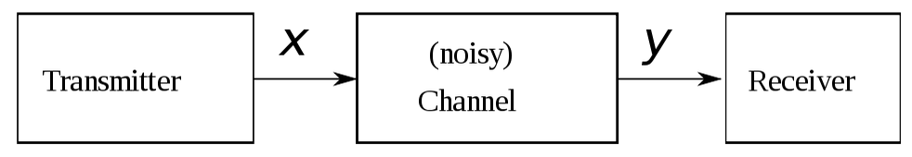
Information Theory
Claude Shannon (1948)
http://en.wikipedia.org/wiki/Information_theory
Sender/Transmitter
Channel
Receiver
All channels have noise.
Establish presence
Norbert Wiener (1948)
Feedback
Notes:
Claude Shannon and information theory
Tranmsmitter – channel – receiver model
Info sent from the transmitter to receiver through a channel with some amount of noise
Info quality is only as good as what is received
All channels have noise; talk from 5 feet in office; shout from 50 feet across the parking lot
Foundation for most any field involving signal processing. This includes computers and humans.
Same year Norbert Weiner explicated feedback
Reverses model to send feedback information from receive back to transmitter
so channel noise factored 2x

Slide 9
Types of noise

Slide 10
Too much or unnecessary
Reply-all
Keeping everyone in unnecessary loops
Everyone acts or nobody acts; No clear ownership of the task.
Notes:
First responder crowd of civilians
First responder crowd of EMTs

Slide 11
Too vague
Pronouns
Email subject lines
Notes:
Have you fixed that thing yet?
Tell me the ticket number and outcome expected.

Slide 12
Receiver not ready
Yt?
Have a moment?
Impact of interruption
Emphasize team time over individual time
Notes:
Not exactly noise but example of communication model breakdown is when the receiver is not ready.
YT? Have a moment?
Depending on task and flow, it could take 10-20 minutes for the person to resume flow.
Emphasize team time over individual time

Slide 13
Queuing behavior
Notes:
Queuing helps us know what to do next.

Slide 14
Who gets my time?
Who has priority?
What is important?
When should I check?
Notes:
Queuing is dynamic. It changes.
This is a conversation you need to have across your teams for setting expectations.

Slide 15
Service disciplines of queues
First in first out
Priority
Shortest job first
Notes:
Typically we’re favoring priority while trying to not let small, minor items slip through the cracks.
There is not a single answer. YMMV.

Slide 16
Behaviors in an inefficient queue
Balking: Won't start
Jockeying: Switch between queues
Reneging: Leaves queue
Notes:
Balking: wont’ start
Jockeying: switch between queues. Email sent then ping in chat moments later.
Reneging; person leaves queue.

Slide 17
Manage across
Project team
Platform team
Notes:
Colleagues should be able to trust you and know you will deliver. If you are unavailable, this should not be a surprise.

Slide 18
Manage up
Treat standups like a job
Getting pinged? Check yo self.
Presence updates (:coffee:)
Notes:
Most of your communication to managers can be accomplished through standup meetings as well as ticket updates.
Be 1 minute early to standups. Have your 1,2,3s ready.
If you are getting ad-hoc pings, first be sure you are updating your tickets and following common workflow.
Presence updates go a long way to establishing trust and confidence.
Let people know when you’re online and working for the day. Let people know when you have an unexpected time away from the keyboard for a broken car or doctor’s visit.

Slide 19
Manage down
Meeting details plz
Do not cancel
Check tickets for status first
Check calendars before sending an invite
Notes:
You should provide enough meeting information ahead of time to ensure that the team values the meeting.
Ask for team feedback how to make meetings more valuable.
Do not cancel meetings unless unavoidable. Do not make this a habit.

Slide 20
Leave email to the robots
Use your project management, tracking and chat tools.
<3 Transactional email
Tickets should have clear history
Chat is not fact; Update tickets

Slide 21
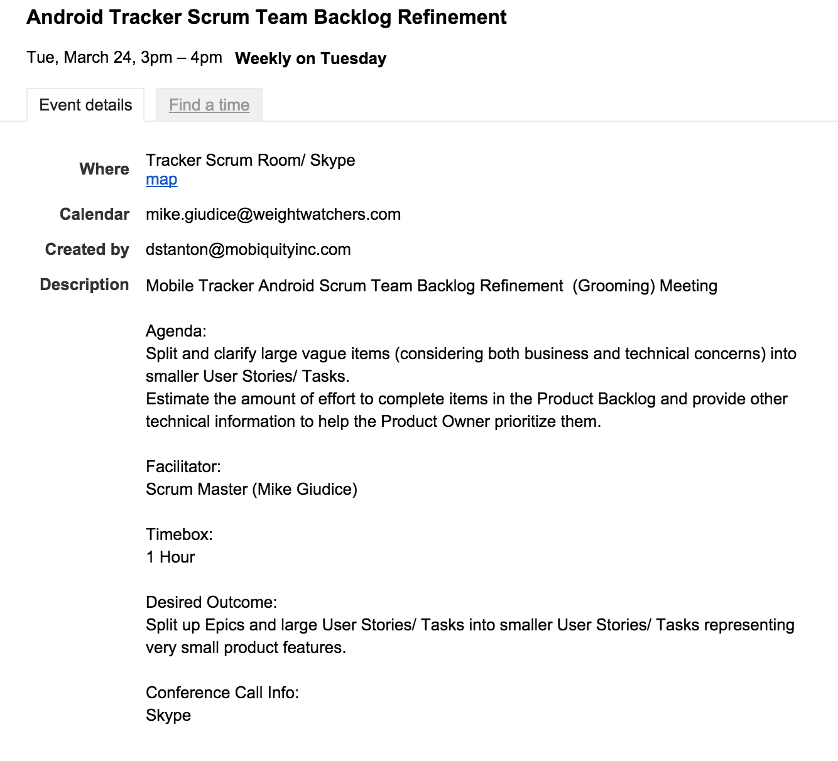
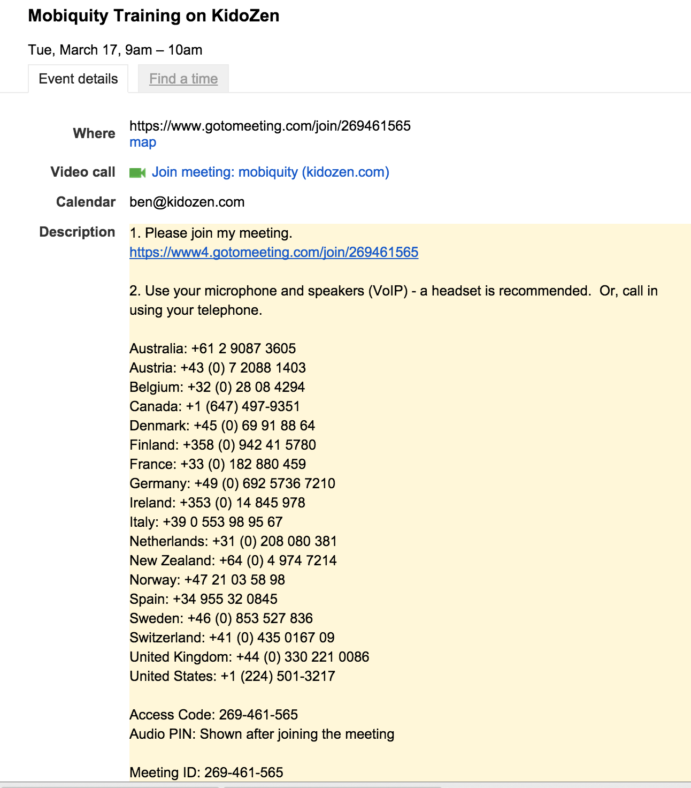
Calendar good/bad

Slide 22
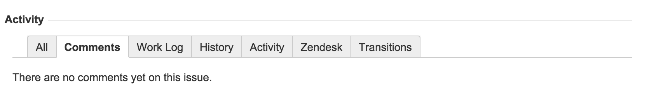
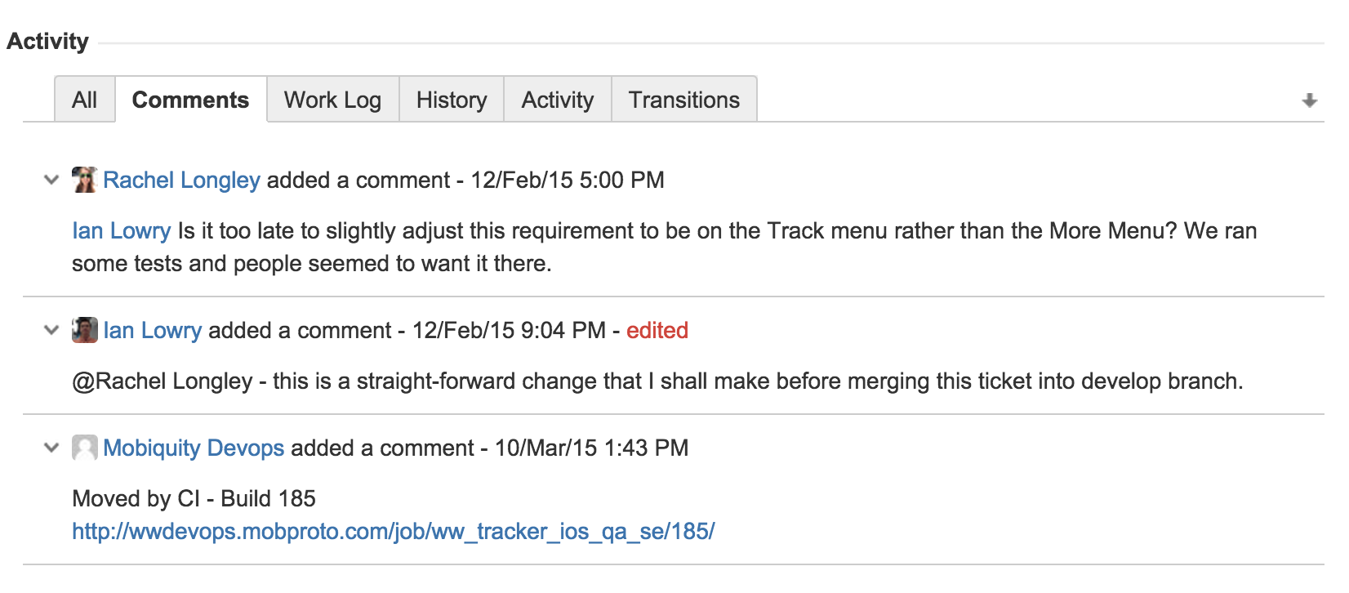
JIRA good/bad

Slide 23
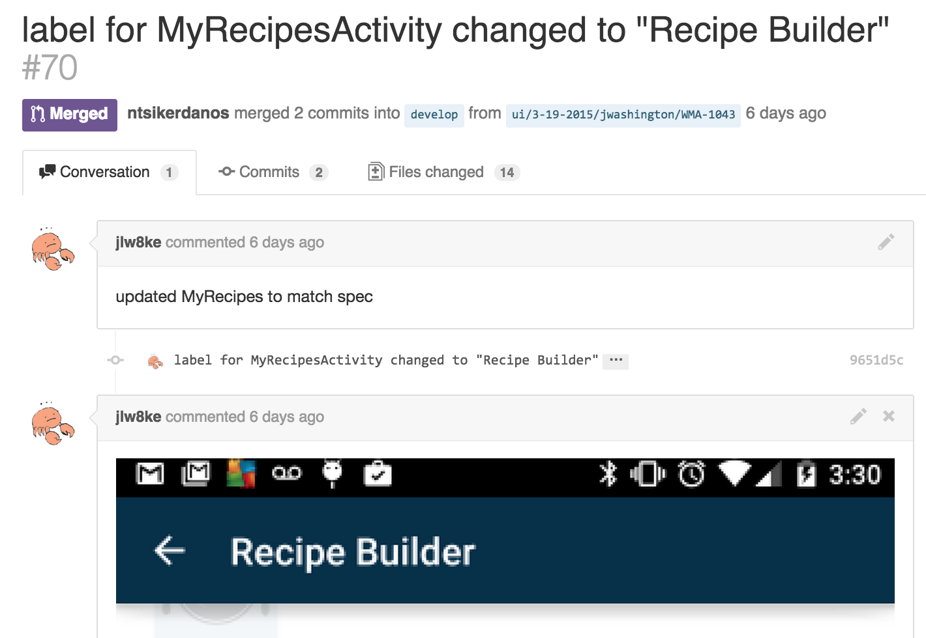
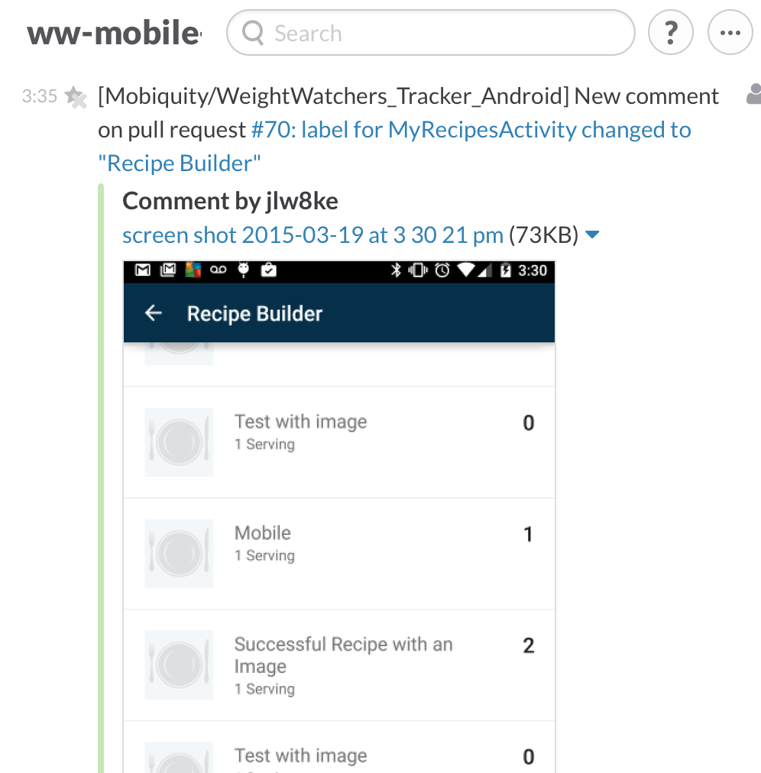
GitHub good; Slack good

Slide 24
Email good/bad
Notes:
Reply-all forever
Multiple topics and switch topics
No clear chain of command; Who should be doing what and why?

Slide 25
Value team time when setting meetings
We all need focused time
Don’t be late
Disagree after
No placeholders
Notes:
* Be mindful to allow people long blocks of focused time. Splitting the day into tiny meetings is death.
* Don't be late. 5 minutes late * 8 people = 40 minutes lost.
* Have process disagreements after the fact. Not good for timing or morale.
* Don't create placeholder meetings; likely will be cancelled and make people grumpy.

Slide 26
Tiered communication urgency
Can answer wait until tomorrow’s standup?
Knowing “soon” helps us maintain velocity
Knowing “now’ unblocks me
Prefer to @mention before DM.
Notes:
If Standup will clarify: update ticket comments. Proactive blocker prevention instead of announcing during standup. Blockers should not be surprise during standup.
Soon = a couple hours. @mention in chat. Be sure you are checking chat notifications between tickets or every couple hours if head’s down.
And stand up every couple hours for your health too. Sitting all day is bad.
Direct messages in Team chat warrants immediate attention. Don’t abuse and distract with this power.
If you don’t check chat rewind between tickets or every few hours, you should be pestered by teammates. You are being a bad citizen.

Slide 27
Exceptions
It is your job to understand your tools
Break rules intentionally
Break for team gain
Every “have a minute” affects the team.
Notes:
* Know the common standards of your tools before you break the rules.
* Know why you are breaking the rule.
* You break the rule for overall team gain and not because you are anxious.
* When you interrupt someone, you are having a significant impact on the team. It could take up to 20 minutes for the person to re-enter maximum flow after an interruption.
cool to ask “have a minutes” in the kitchen, the hallway or the gameroom; but not at the keyboard.
Send them an @mention and wait for mutual availability.
]if you keep missing each other, schedule some time

Slide 28
Balance urgency and distraction
Maximize team productivity
Minimize distraction
Leave work satisfied

Slide 29
Thank you for your time and attention

